Slide 1


Leveraging Social Context in Fake News Detection
Van Hoang Nguyen¹, Toshiki Tomihara²,
Preslav Nakov³, Yohei Seki², Kazuari Sugiyama⁴, Min-Yen Kan¹
¹ Web IR / NLP Group (WING), NUS ² University of Tsukuba ³ Qatar Computing Research Institute, HBKU ⁴ Kyoto University
Notes:
Thank you for the opportunity to share my FYP on live. I choose this over recorded video because I hope this can be more interactive. If there is any point that I have not made clear, please let me know. My FYP is on …

Slide 2
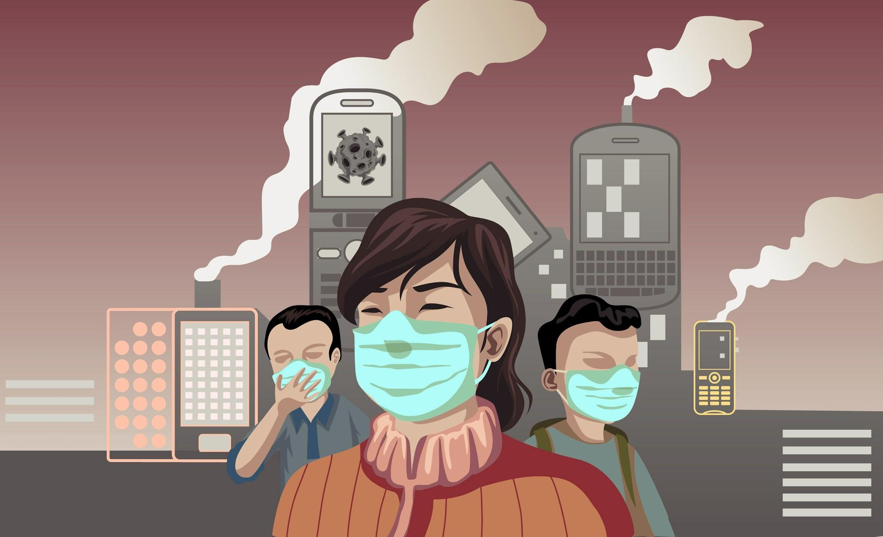

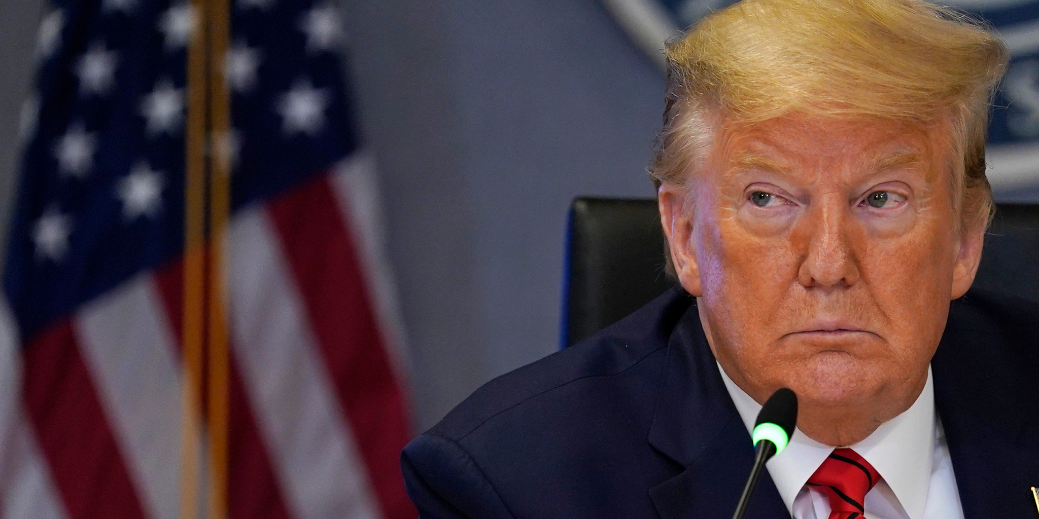

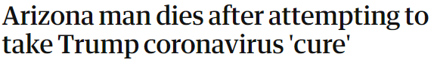
“We’re not just fighting a pandemic; we’re fighting an infodemic.” - WHO
Notes:
Tackling fake news has become more urgent than ever. We are living through a historical pandemic, but according to the WHO, we are not just fighting a pandemic, we are fighting an infodemic or the widespread of the false information. Fake news does not damage the reputation of any presidential candidate this time, it is taking people’s lives. And sadly, it comes from someone who is supposed to inform the public on scientific facts.

Slide 3

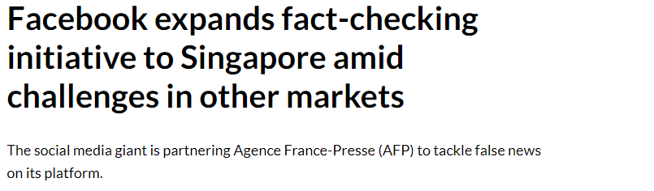

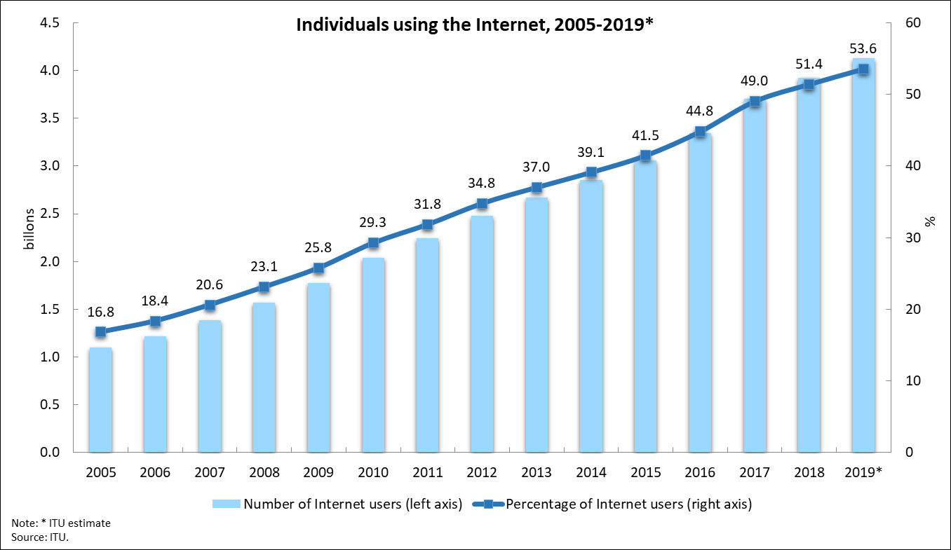

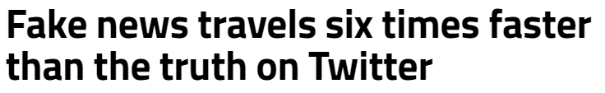
Verifying information at scale
Notes:
The social media are those responsible for this infodemic. Facebook has taken action by employing third party to fact-check the content on its platform. Unfortunately, fake news spreads very fast, six times faster than the truth, and the internet is growing very rapidly with 1 billion new users every 5 years. So it’s not just about correctly verifying information but also how to do it at large scale.

Slide 4
Outline
Introduction
Background
Automatic fake news detection
Methodology
Social context Graph
Factual News Graph - FANG
Results & Discussions
Demonstration
Conclusion & Future work
Notes:
So those were the background of our work. This is the outline of today’s presentation. We started with the background and will move on with the automatic fake news detection. We will later explain the methodology of our research, its results and discussions. We will wrap up with a small practical demonstration before concluding and presenting the future directions.

Slide 5
Outline
Introduction
Background
Automatic fake news detection
Methodology
Social context Graph
Factual News Graph - FANG
Results & Discussions
Demonstration
Conclusion & Future work

Slide 6
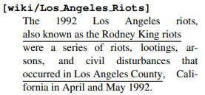
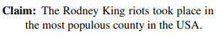
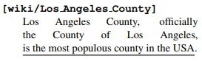
Evidence-based Fact checking
Evidence DB
look up
analyse
Accurate
Highly explainable
Assume fact-checkable information
Require sufficient evidences
Thorne, James, et al. "FEVER: a large-scale dataset for fact extraction and verification." (2018)
Notes:
A first idea to crosses people’s mind to identify fake news would be to fact-check based on evidence. Given a questionable claim, for example ..., we can look it up in some evidence database. If we know that the riot took place in LA and LA was indeed the most populous county in the USA, then we can come up with the final verdict of “support”. This evidence-based fact-checking approach is highly accurate and explainable, but assume that the information is fact-checkable. For example, if it was a fake image, evidence-based fact-checking would be much harder. It also requires a substantial amount of time to gather sufficient evidences.

Slide 7


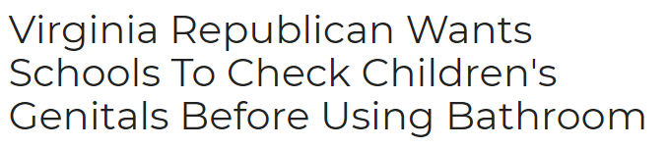
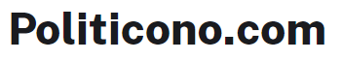
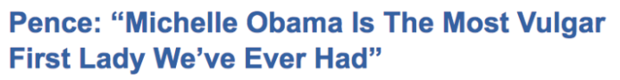
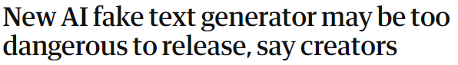
Style-based approach
Require no explicit evidence
Less explainable
Sensational
Appalling
Notes:
Another approach would be to determine fake news based on its writing styles and delivery. These are 2 headlines of fake news and they are both sensational and appalling. Our machine learning classifier can exploit this feature to detect fake news without any explicit evidence, but will be less explainable. Furthermore, even the AI are getting better at producing false stories, so this approach would not guarantee its long-term performance.

Slide 8
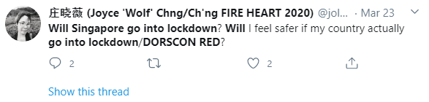

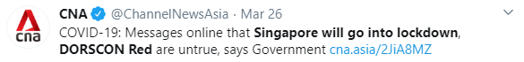
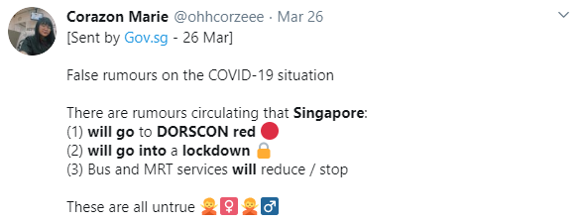
Contextual Fake News Detection
Questionable source
Denied by reputable news channel
Singapore will go into lockdown, DORSCON Red
Require no explicit evidence
No assumption of information
Divided stances
Less explainable
Notes:
A recent trend in fake news detection is to look at the news spreading context. Specifically, given a questionable claim, like “Singapore will go into lockdown, DORCON Red”, we can tell from its source or how the public perceive this information. If the source is a Whatsapp, the news can very well be a questionable rumor. It can be more suspicious if the news divided the public opinions or stances, or even is denied by a reputable news channel. This approach require no explicit evidence and make no assumption of the information. It can be less explainable but this can be improved.

Slide 9
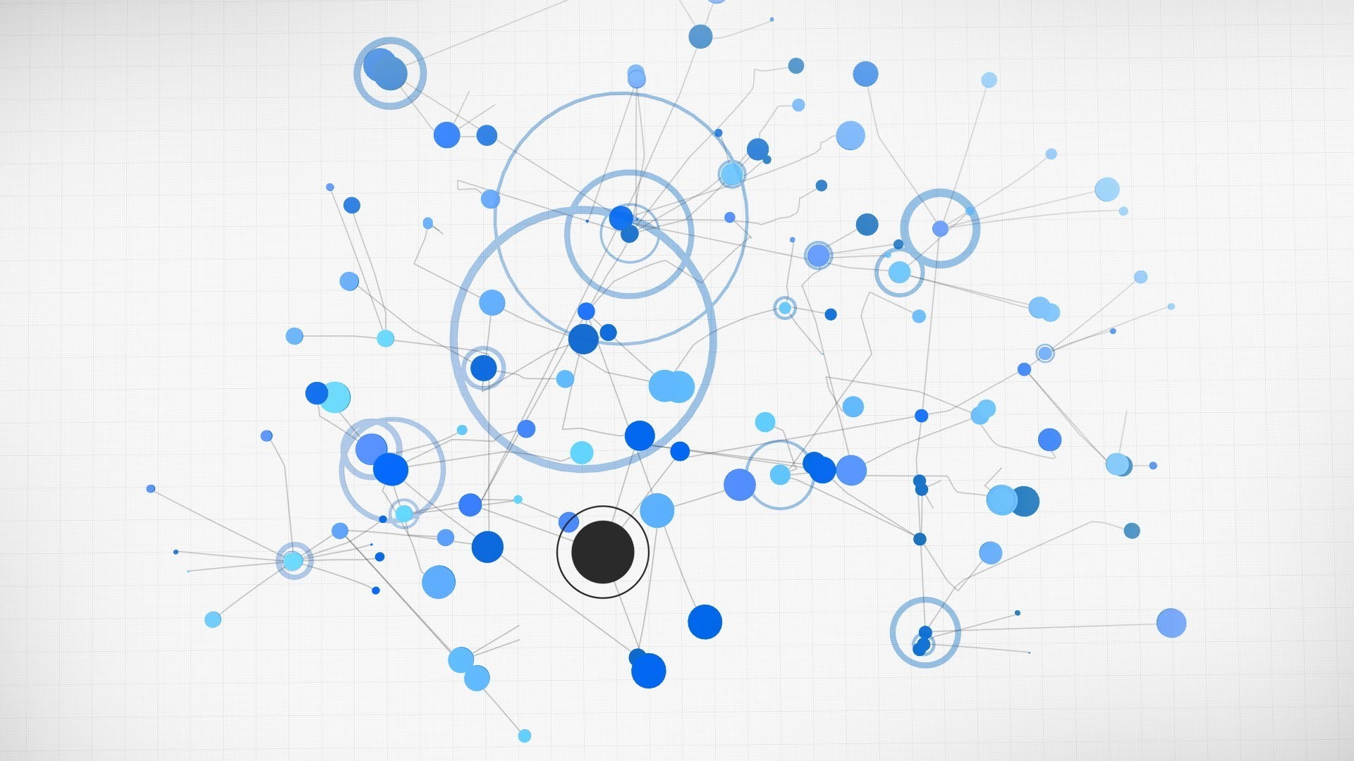
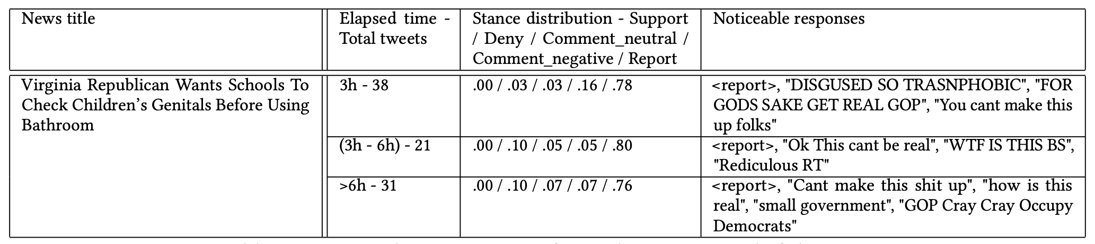
What social context tells about fake news
Fake news has many engagements within the first 3 hours.
The appalling content of fake news attracts negative comments, alongside with word-for-word report.
As time passes, the news gets invalidated by social users.

Slide 10
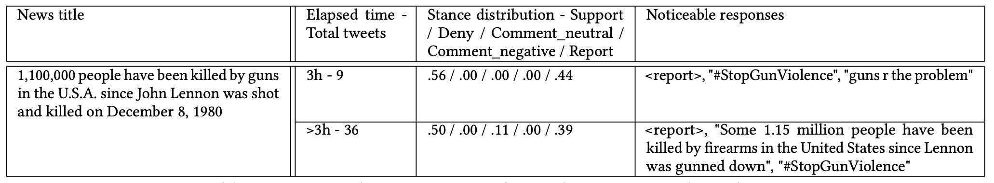
What social context tells about real news
Actual news has moderate engagements within the first 3 hours.
The engagements are mainly supports or neutral comments.
The stance distribution stabilises relatively quick comparing to fake news.

Slide 11


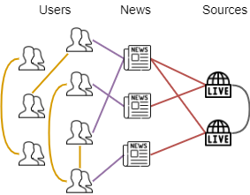
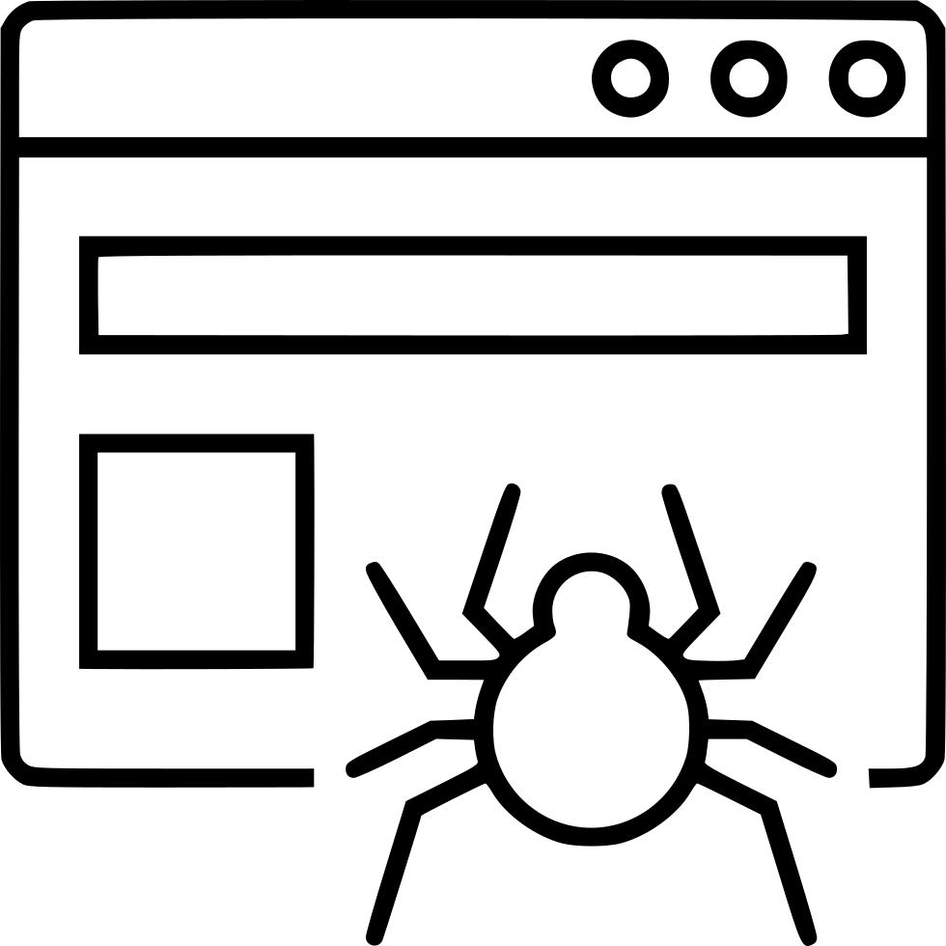

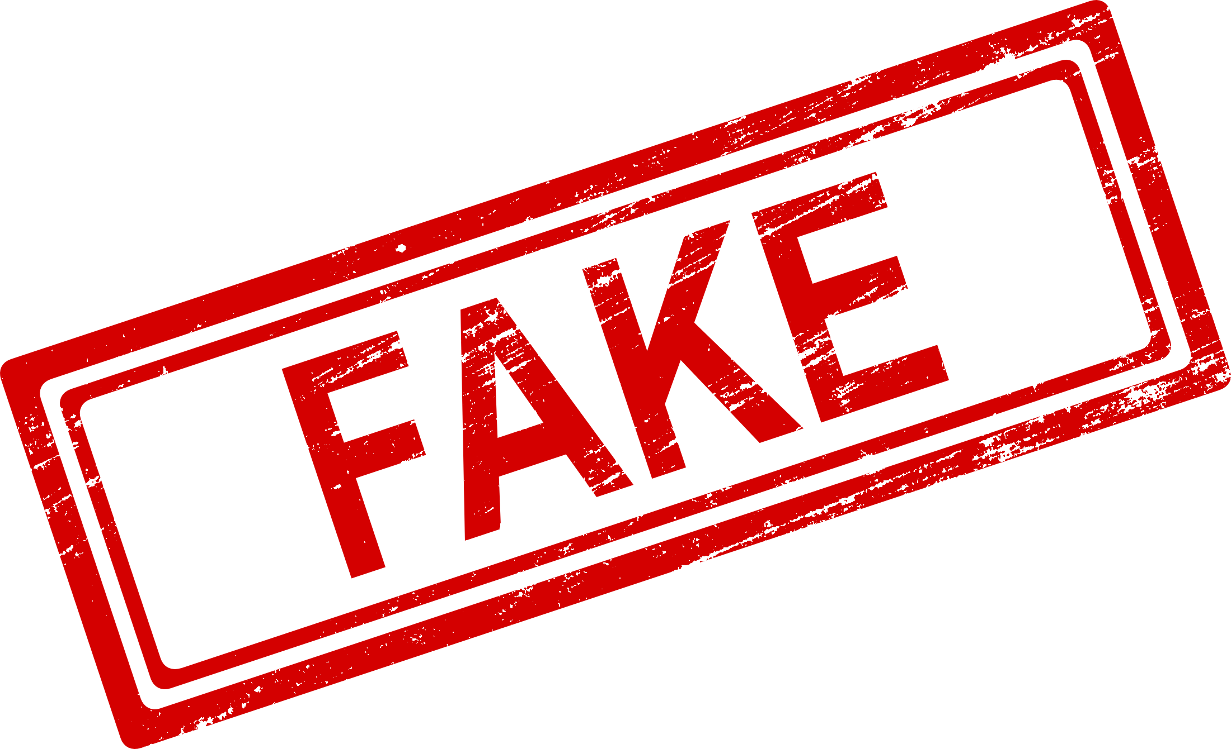

Contextual Fake News Detection
Search
Social context
Questionable claim
Prediction
Notes:
So this would be our system flow for contextual fake news detection. We first receive the questionable claim, crawl its mentions on social media, contruct its social context, input it in some learning framework and return the prediction.

Slide 12
The news spreading ecosystem
Troll/bot user classification
Fake news detection
Singapore will go into lockdown, DORSCON Red
Source factuality classification
Notes:
We are also interested in the news spreading ecosystem as a whole. If we successfully detect fake news, we can also identify the trustworthy sources and troll/bot users on social media, as these tasks are closely linked with each other.

Slide 13
Contributions
We provide a novel graph representation for the news spreading context
We propose FANG, a novel graph learning framework that
explores the unique structures of social context
is minimally supervised
We improve the performance of
fake news detection
downstream source factuality classification.

Slide 14
Outline
Introduction
Background
Automatic fake news detection
Methodology
Social context Graph
Factual News Graph - FANG
Results & Discussions
Demonstration
Conclusion & Future work
Notes:
Next, we will dive deep into the methodology of our research.

Slide 15
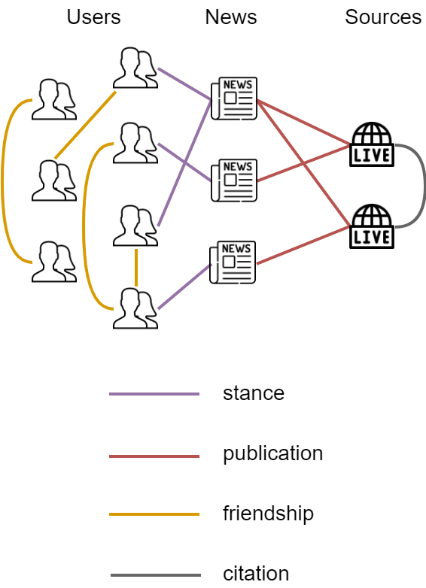
Context Graph
A collection of highly associated social entities and their interactions
Graph Learning Frameworks can learn
Conditionally dependent representations
Network information exchange
Underlying structure (user communities, news network,...)
Semi-supervised tasks with limited training labels
Notes:
We are not the first to examine the news spreading context, but one of the first to formulate a comprehensive context graph. As social context is a collection of highly associated social entities which are users, news, and sources, and their interactions, formulating them as a graph can be beneficial. We can apply graph learning frameworks that learn….

Slide 16
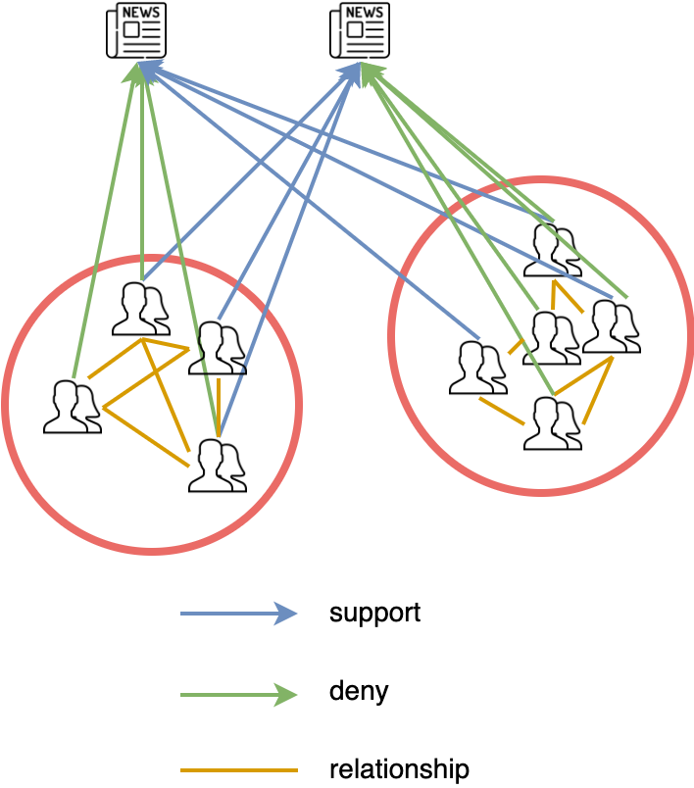
Reducing the echo
Social users follow like-minded people, forming communities promoting their narratives.
Model filtering bubbles with a graphs
Notes:
There is also the phenomenon of filtering bubbles or echo chambers where … These bubbles are the breeding ground of fake news as they can be circulated very fast without hardly any rational invalidation. Fortunately, the filtering bubbles, built on the basis of tightly connected community, can be modeled with graph, and is one major advantage of graph-based models versus non graph-based models.

Slide 17
Context Graph: Relations
 | User | News | Source
User | Friendship | Stance
News | Stance |  | Publication
Source |  | Publication | Citation

Slide 18
Term Frequency × Inverse Document Frequency
The Nobel Peace Prize is one of the five Nobel Prizes established by the will of Swedish industrialist, inventor, and armaments manufacturer Alfred Nobel, along with the prizes in Chemistry, Physics, Physiology or Medicine, and Literature.
The Nobel Peace Prize is one of the five Nobel Prizes established by the will of Swedish industrialist, inventor, and armaments manufacturer Alfred Nobel, along with the prizes in Chemistry, Physics, Physiology or Medicine, and Literature.
The Nobel Peace Prize is one of the five Nobel Prizes established by the will of Swedish industrialist, inventor, and armaments manufacturer Alfred Nobel, along with the prizes in Chemistry, Physics, Physiology or Medicine, and Literature.
The Nobel Peace Prize is one of the five Nobel Prizes established by the will of Swedish industrialist, inventor, and armaments manufacturer Alfred Nobel, along with the prizes in Chemistry, Physics, Physiology or Medicine, and Literature.
Term Frequency: Actually a count. Count of a term in the document.
Inverse Document Frequency:
The rarity of a term across a corpus of documents.

Slide 19
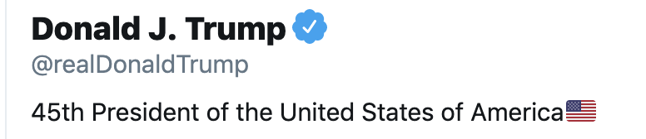
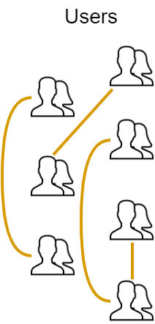
Context Graph: Users
User feature
Tf-idf vector + weighted word-embedding from twitter descriptions
User relations
Follower/Following

Slide 20
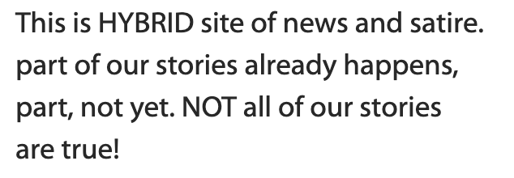
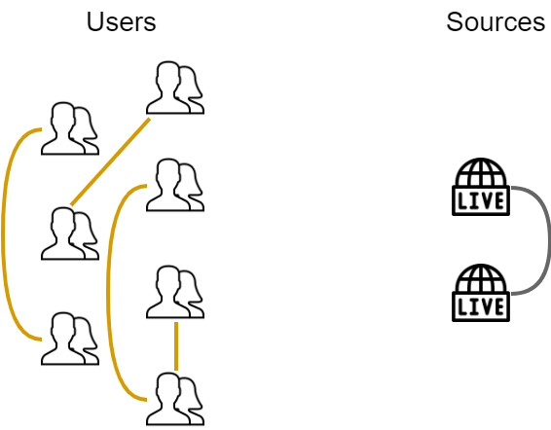
Context Graph: Sources
Source features
Tf-idf vector + weighted word-embedding from homepage and about-us content
Source relations
Citationship

Slide 21
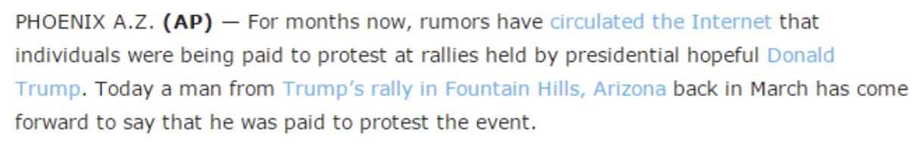
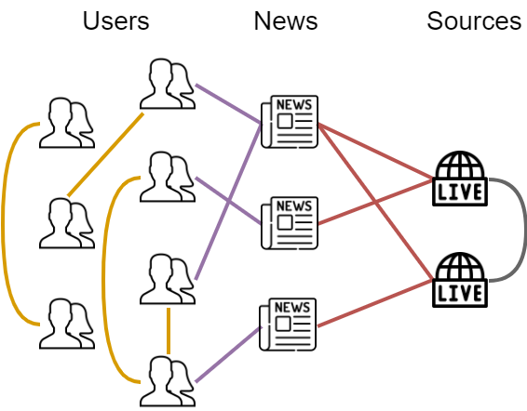
Context Graph: News
News features
Tf-idf vector + weighted word-embedding from news content
News relations
Source-news publication
User-news stance
Support
Deny
Comment (neutral/negative)
Unrelated
How do we know these stances?

Slide 22
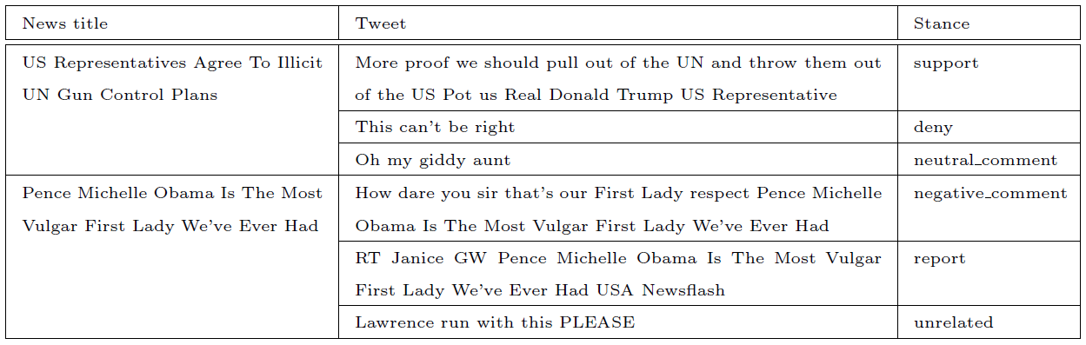
Stance detection
The first stance dataset for news title - tweet

Slide 23
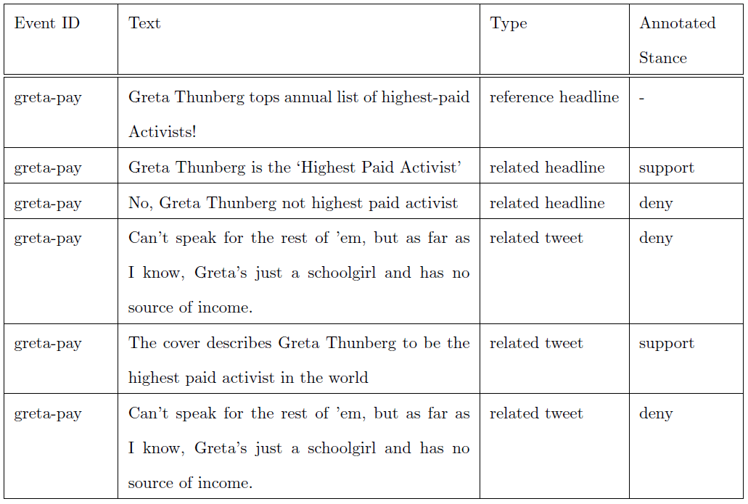
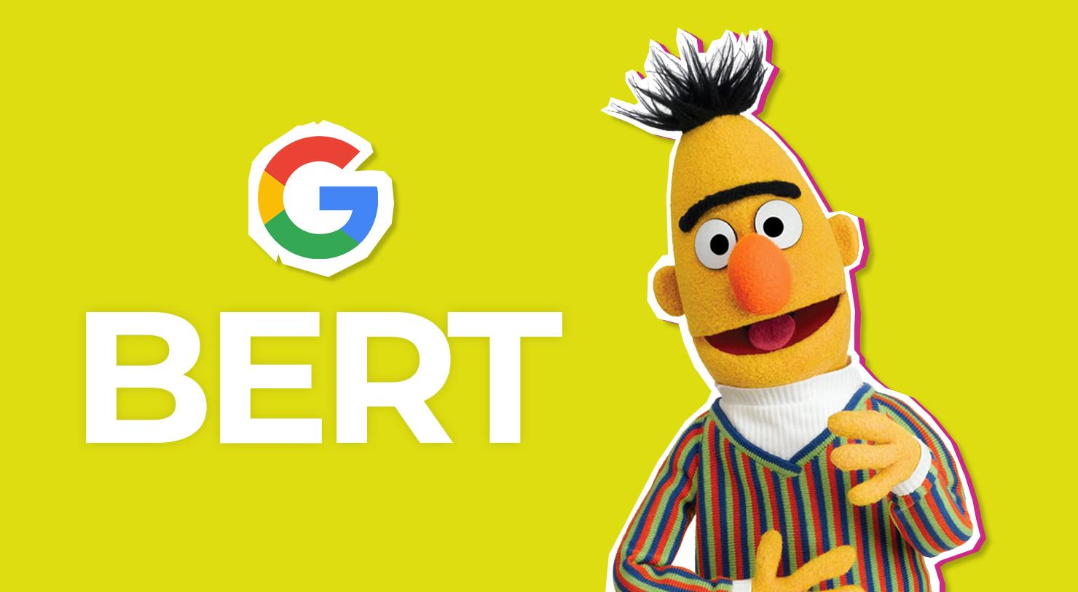
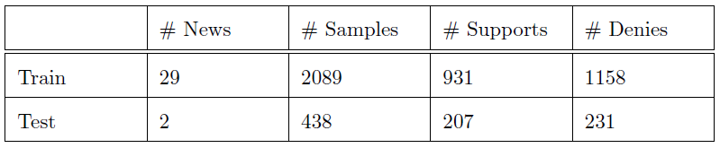
Cohen’s kappa = 0.7776
F1 = 0.8379

Slide 24
Outline
Introduction
Background
Automatic fake news detection
Methodology
Social context Graph
Factual News Graph - FANG
Results & Discussions
Demonstration
Conclusion & Future work

Slide 25
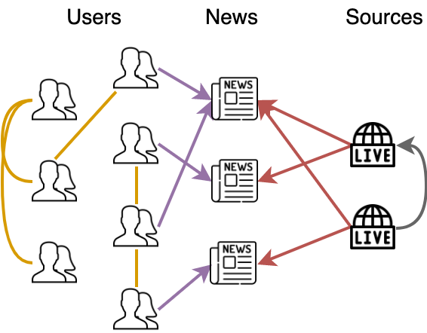
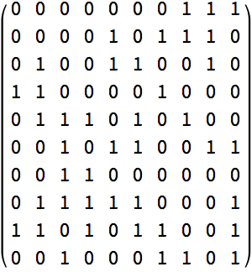
Graph Convolutional Network (GCN)
Transductive
Matrix operations are costly
Inexpressive with heterogeneous graph
Expensive
Little label interaction
Convolution
unseen?

Slide 26
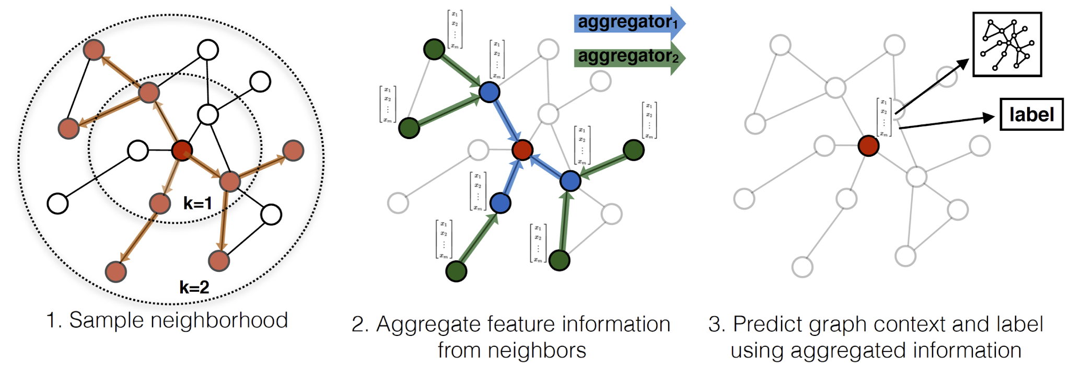
Graph Sage
Inductive
Scale well with graph relations
Representation is both learned unsupervisedly and supervisedly
Temporal aggregation

Slide 27
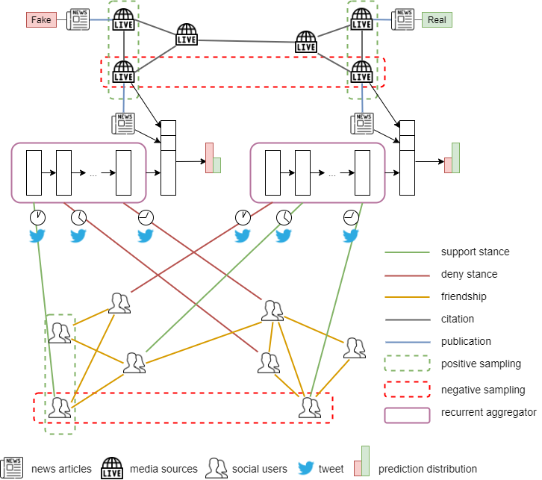
FANG
Representations are jointly optimized on 3 losses
Proximity loss (unsupervised)
Stance loss (self-supervised)
Fake news detection loss (supervised)
Notes:
We will discuss in details how the primitive idea of GraphSage is used in FANG. The entity representations are optimized based on 3 losses. First is the proximity loss. This loss guarantees that connected entities are assigned similar representations while disconnected entities are assigned separated representations. Second is the stance loss being supervised by the self-generated stance from the mentioned stance detector. This loss ensures that entities sharing the same stance are assigned similar representations while entities sharing different stance are assigned separated representations. Third is the fake news detection loss where we optimized on the main objective of detecting false information.

Slide 28
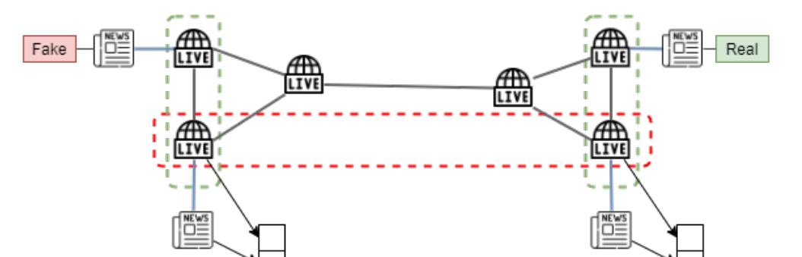
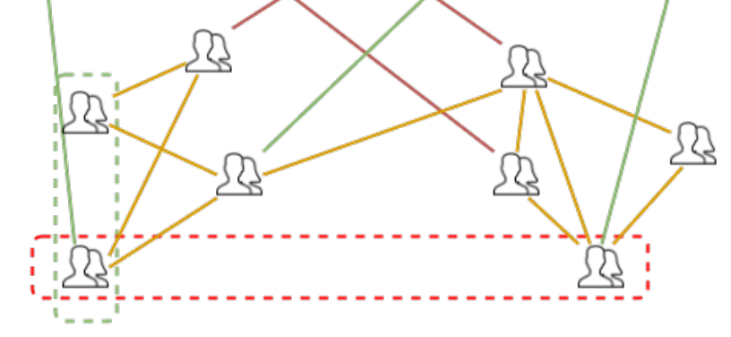
FANG
Proximity loss
Positively sample neighbor in random walk style
Walk parameters customizable for different entities
Negative sampling based on distance in feature space
Notes:
The idea behind proximity loss is very similar to GraphSage sampling and aggregation. If we are interested in representing this user, we can sample their neighbor as similar of positive samples by randomly walk around. The length of this walk can be customized based on the source entities. For example, we can have a longer walk for user nodes and a shorter walk for news and source nodes. In proximity loss, besides the similar samples, we also need the different or negative samples. This can be obtained by sampling those samples who are both disconnected and have largely different features with the source node. Our final proximity loss L_loss, is the sum of the positive sampling loss and the negative sampling loss.

Slide 29
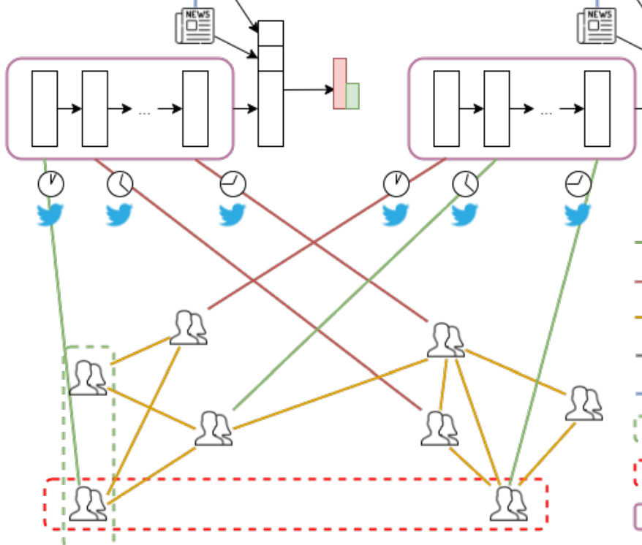
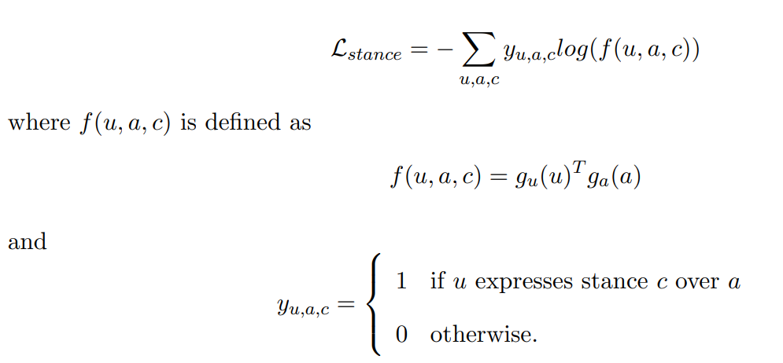
FANG
Stance loss
Further improve representations with auxiliary stance classification
Labels obtained from stance detector
Notes:
We also employ a similar idea in stance loss: users who share common stance on similar sources should have their representations closed to each other. We achieve this by training the model to classify the stance between an engaged user-news pair. The stance labels are obtained from the stance classifier described earlier.

Slide 30
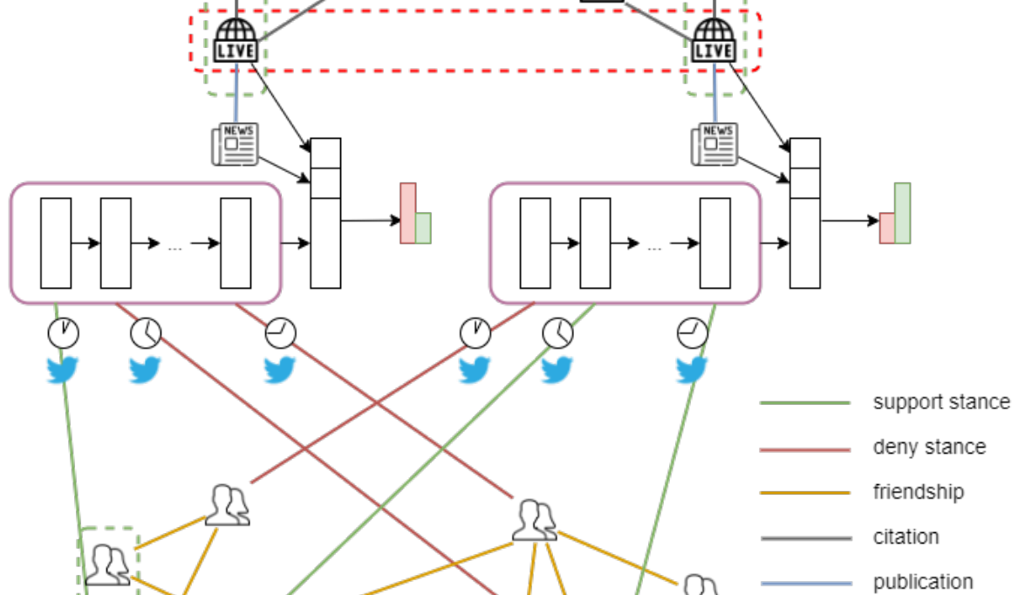
FANG
Supervised fake news detection
Temporality awareness with recurrent aggregator
Attention mechanism
Improve encoding of long engagement sequences
Improve explainability
Notes:
Finally, the model is optimized according the main supervised fake news detection objective. From our observation, the timing of engagements is very important in differentiating fake and real news, so we employed a recurrent aggregator, a long-short term memory specifically. We improve the basic LSTM with an attention mechanism that not only improves encoding quality but also the model explainability.

Slide 31
Outline
Introduction
Background
Automatic fake news detection
Methodology
Social context Graph
Factual News Graph - FANG
Results & Discussions
Demonstration
Conclusion & Future work
Notes:
We have described FANG - the novel graph framework of our research to learn the proposed context graph. Next, we will examine and discuss the performance of FANG on fake news detection

Slide 32
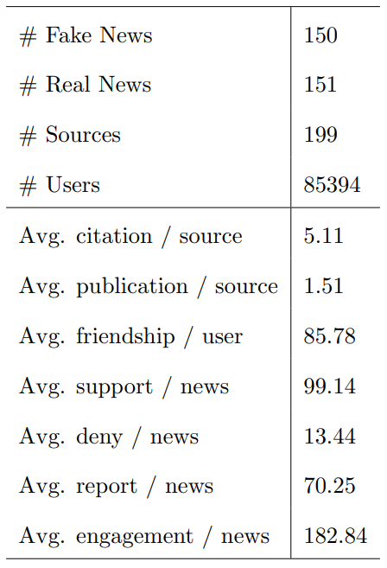
Dataset
Major nodes are users
Avg. degree for sources and news nodes are fewer than users
Avg. length of engagements is long enough for recurrent aggregator
Notes:
Let us first describe our fake news dataset. It is composed of 300 fake and real news, approximately 150 each, published by 199 sources in total and circulated through a network of 85 thousands users. As you can see, the landscape of social context is dominated by users, and user node also have higher average outward degree. Fortunately, FANG is sampling based, which means we can always choose to sample users and sources more if those nodes are more relevant to our task without being overwhelmed by users. The average length of engagement is 182 which is long enough for recurrent aggregator such as LSTM.

Slide 33
Research Questions (RQs)
RQ1: Does FANG work better than content-only models, contextual Euclidean models and contextual graph models?
RQ2: Does FANG work well with limited training data?
RQ3: What is the rationale behind temporality awareness of our model?
RQ4: How effective is FANG's representation learning?
Notes:
First, we want to know if FANG is actually better than content-only models - those that do not model context at all. We examine if the social graph is helpful by benchmarking FANG with contextual Euclidean model and how does FANG fair with another graph learning framework.

Slide 34
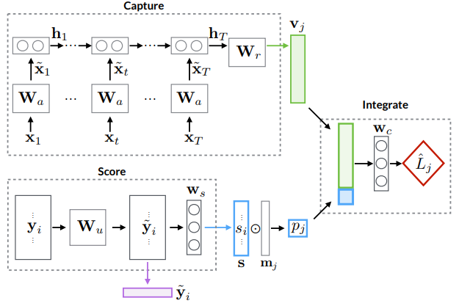
Euclidean baselines
CSI (Ruchansky, 2017)
Aggregate social engagements using LSTM
Model social context not as a graph but as a Euclidean object
Concatenate source and user attributes
Notes:
For euclidean baseline, we are using the CSI model, which is a fake news classifier that also aggregates social engagements using LSTM. The major difference between CSI and our approach is that CSI does not model the social context as a graph but as a Euclidean object. We concatenate the source and user attribute the CSI to make it equivalent to FANG.

Slide 35
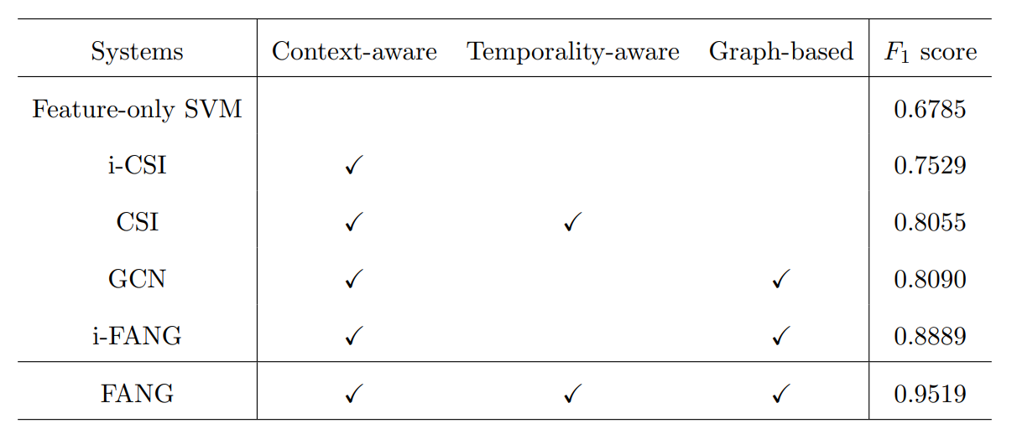
FANG vs Content- and Graph-based Baselines (RQ1)
Improvement from context: 7.44% (i-CSI) to 27.35% (FANG)
Notes:
Let us explain the result table. The first column lists the systems used in our experiments. Some systems have 2 variant, one with i in front, indicating temporality insensitive and one without i in front indicating temporality sensitive. We describe each system on the 3 metrics: whether they are context-aware, temporality-aware and graph-based. We measure all system performance in term of F1 score, which is the harmonic mean between precision and recall. Firstly, we can observe that all systems that are context-aware out-perform feature-only SVM, which is a context-unaware system, ranging from 7.44 improvement in i-CSI to 27.35% improvement in FANG. This justifies the importance of being aware to context besides content in detecting fake news.

Slide 36
FANG vs Content- and Graph-based Baselines (RQ1)
Improvement from multi-relational graph: 5.61% (GCN) to 13.6% (i-FANG)
Notes:
Secondly, all graph-based systems, GCN and FANG improves the non graph-based or euclidean system, CSI. This improvement ranges from 5.61% to 13.6% in terms of F1 and verifies the effectiveness of modelling social context as a graph.

Slide 37
FANG vs Content- and Graph-based Baselines (RQ1)
Improvement from FANG itself from GCN: 7.99%
Notes:
Between 2 graph-based systems, GCN and i-FANG, i-FANG gives better results by 7.99% in terms of F1. This improvement from FANG can be explained by the better structural representation thanks to dynamic proximity sampling.

Slide 38
FANG vs Content- and Graph-based Baselines (RQ1)
Improvement from temporality: 5.26% (CSI) to 6.3% (FANG)
Notes:
Finally, we can observe the benefits of being temporality-aware. 2 time-sensitive variants, CSI and FANG outperform their time insensitive variant by 5.26% and 6.3% therefore justify our choice of a temporal aggregator. These experiment results show that at the macroscopic level, our proposed FANG model, thanks to its context-awareness, temporality awareness and graph formulation, outperforms other less comprehensive baselines. This conclusion has verified the first research question.

Slide 39
Research Questions (RQs)
RQ1: Does FANG work better than content-only models, contextual Euclidean models and contextual graph models?
RQ2: Does FANG work well with limited training data?
RQ3: What is the rationale behind temporality awareness of our model?
RQ4: How effective is FANG's representation learning?
Notes:
Secondly, we verify if FANG works well with limited training data.

Slide 40
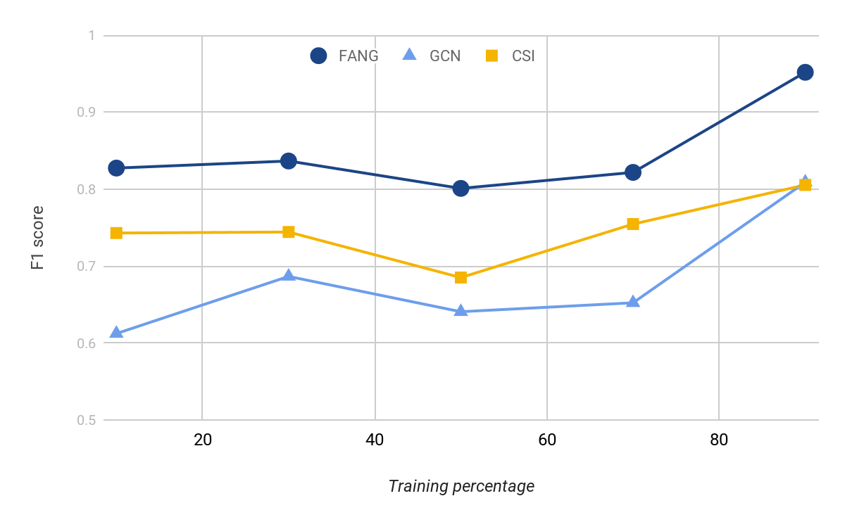
FANG performs comparatively better with limited training data (RQ2)
- 13.07% (0.8274)
- 24.31% (0.6123)
Notes:
This graph is the plot measuring the performance of 3 systems FANG, GCN and CSI across different training availability percentage. Between the graph-based approaches, FANG suffers much less compared with GCN when the data availability dropped from 90% to 10%. Specifically, the performance of FANG in terms of F1 only drops by 13.07% while GCN’s drops by 24.31%. This can be explained as FANG also optimizes for unsupervised proximity loss and self-supervised stance loss that are not heavily affected by the amount of training data. This highlights the robustness of FANG in preserving its performance at given limited training data.

Slide 41
Research Questions (RQs)
RQ1: Does FANG work better than content-only models, contextual Euclidean models and contextual graph models?
RQ2: Does FANG work well with limited training data?
RQ3: What is the rationale behind temporality awareness of our model?
RQ4: How effective is FANG's representation learning?
Notes:
Thirdly, we seek to understand if FANG successfully tells fake and real news appart by being aware of engagement temporality.

Slide 42
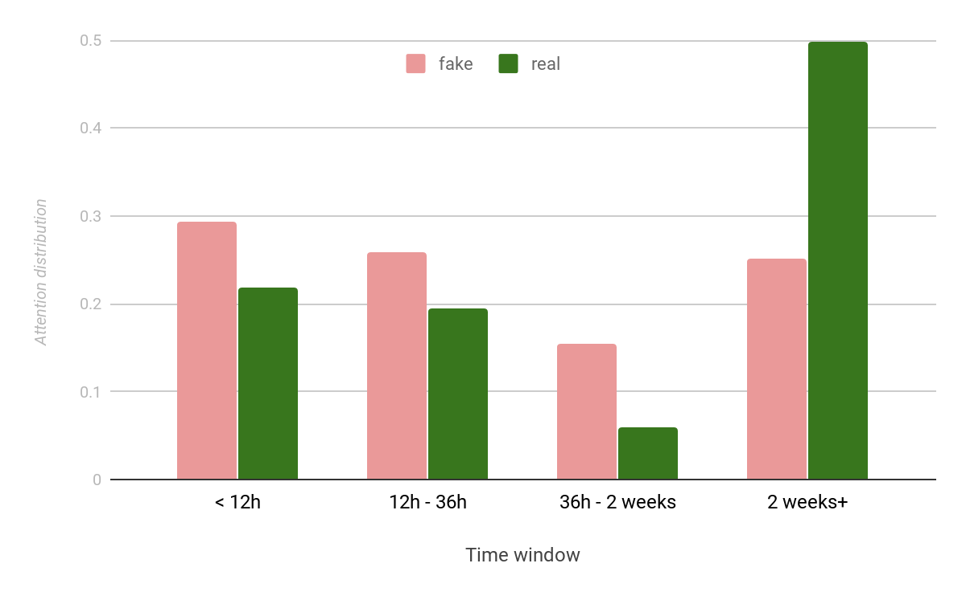
Temporality Study (RQ3)
55% & 40% attention within 36h since publication for fake and real news
25% & 50% attention after 2 weeks since publication for fake and real news
FANG predicts fake news based on short window after publication and real news based on longer duration
Fits our observations on the engagement patterns
Notes:
This graph is the bar chart measuring the attention paid by FANG across time window since publication. As we can observe, FANG pays 55% and 40% attention within 36h since publication for fake and real news. After 2 weeks since publication, this attention distribution reverses when FANG pays 25% & 50% attention for fake and real news. This shows that FANG predicts fake news based on short window after publication and real news based on longer duration. This behavior exactly fits our observations on the engagement patterns, and verify the third research question.

Slide 43
Research Questions (RQs)
RQ1: Does FANG work better than content-only models, contextual Euclidean models and contextual graph models?
RQ2: Does FANG work well with limited training data?
RQ3: What is the rationale behind temporality awareness of our model?
RQ4: How effective is FANG's representation learning?
Notes:
And finally, we examine how effective is the representation obtained by FANG, both intrinsically and extrinsically.

Slide 44
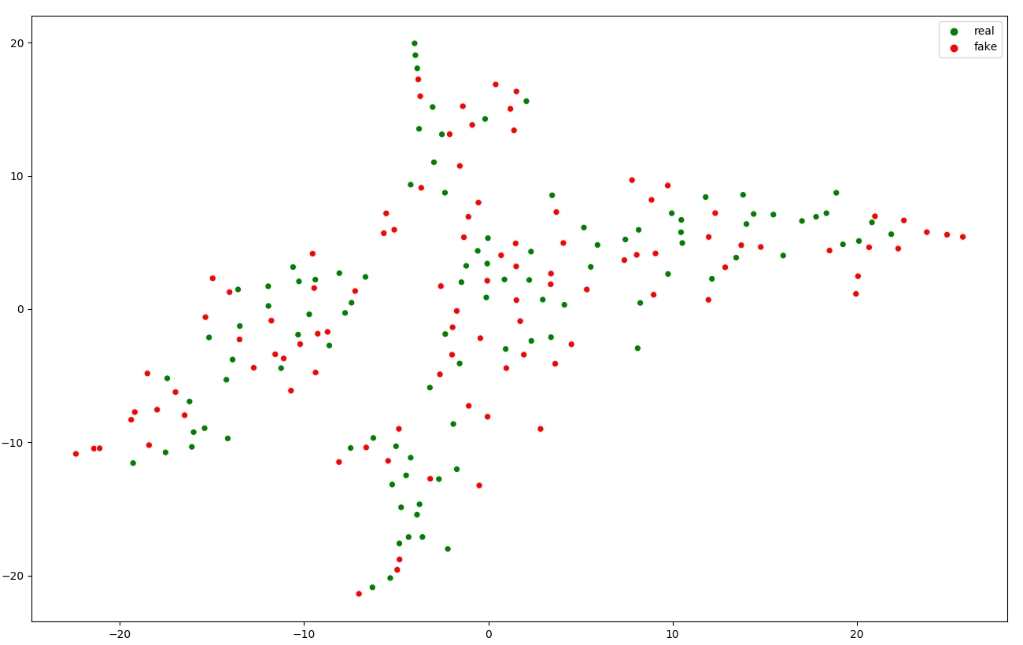
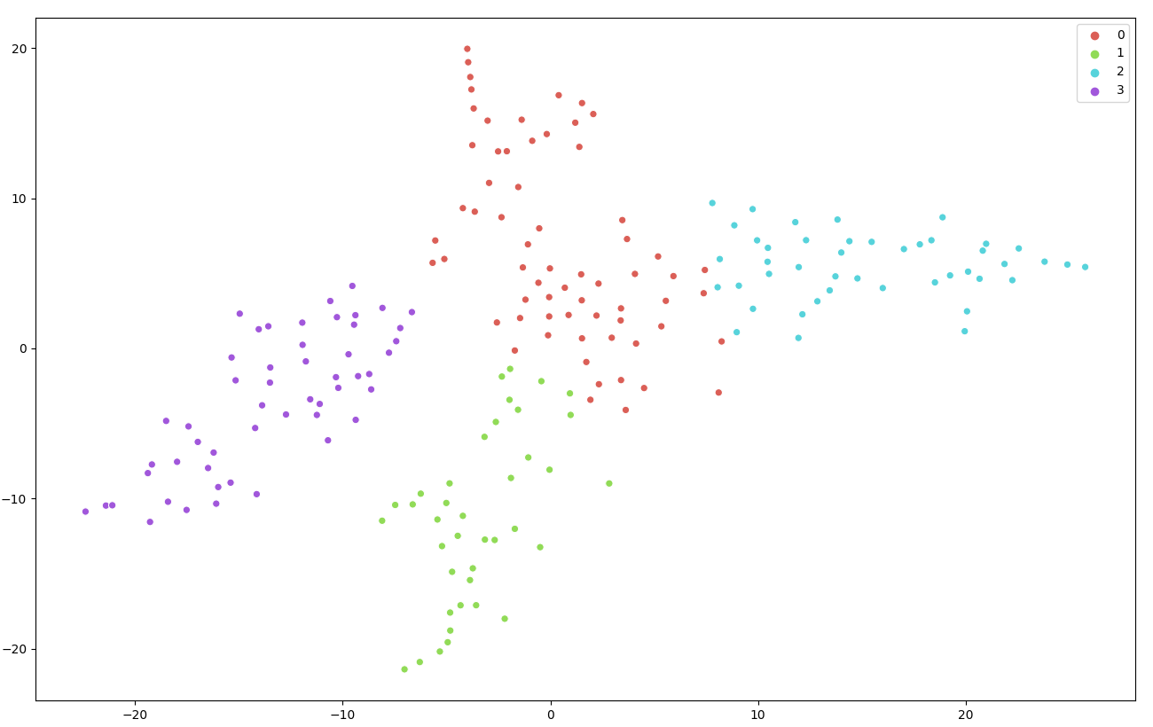
Representation Learning (RQ4) - Intrinsic
Labeled GCN’s representation
Clustered GCN’s representation
Purity = 0.0135
Notes:
These are the 2D visualizations of the news representations obtained from GCN. In the left plot, the real news are colored in green, while the fake news are colored in red. From observations, both real and fake news do not seem to cluster within their label. If we run a mean shift clustering algorithm that helps us identify the natural clustering, we can see that the obtained clusters do not correlate well with the the labels, as measured by the purity score of only 0.01.

Slide 45


Representation Learning (RQ4) - Intrinsic
Labeled FANG’s representation
Clustered FANG’s representation
Purity = 0.3027
Notes:
On the other hand, these are the 2D visualizations of the news representations obtained from FANG. From observations, both real and fake news do seem to cluster within their label. We run a mean shift clustering algorithm to identify the natural clustering, and observe that the obtained clusters correlate well with the the labels, as measured by the much higher purity score of 0.3027. This analysis validates the quality of FANG’s representation in terms of label’s separation.

Slide 46






Source Factuality Classification - Extrinsic
Notes:
We also perform another experiment where directly measure the performance of source representation on the downstream task of source factuality classification. For each of the source medium, we obtain their factuality label based on https://mediabiasfactcheck.com/. Our dataset contains 78 sources in total, divided into high factuality and low factuality as follow. We run Support Vector Machine classifier for the baseline and our proposed improvement. For the baseline, we do not consider any context awareness, whereas for our proposed improvement we concatenate the contextual representation from FANG to each source feature vector. The result shows that our method improves the baseline by 8.15%, and once again verifies the effectiveness of our representation learning.

Slide 47



“Rick Perry says he switched to GOP at a younger age than Reagan did via @PolitiFactTexas He ain't no Reagan.”
“Rick Perry says he beats Ronald Reagan on one account: He switched to GOP at younger age than Reagan did. True.”
True
Notes:
We also examine the model results from the microscopic examples. This news says Rick Perry came to the Republican Party sooner in age than Ronald Reagan receive 2 opposite interaction. However, our model pays more attention to the engagement of Politifact Texas than an insignificant Twitter profile. This can be explained by the description of Politifact Texas, which is a fact-checking project. The model gives the final verdict of real news based on the support of Politifact and this is indeed the real news.

Slide 48





Fake
“Fake news”
“Stupidity fake”
Fake
Notes:
In another example, our model pays a lot of attention on the engagement of this particular Twitter profile. Unfortunately, this profile does not have any description, so we can examine the profile it follows or following it. For the first profile, the user seems to be credible as he is a “proof reader”, whereas the second profile is a tech community. More importantly, if we look at the fact-checking history of this profile, we will see that it has correctly denied a fake news. Therefore, it is reasonable for FANG to pay lots of attention and predicts the news as fake based on the denial given by this profile.

Slide 49
Outline
Introduction
Background
Automatic fake news detection
Methodology
Social context Graph
Factual News Graph - FANG
Results & Discussions
Demonstration
Conclusion & Future work

Slide 50



Demonstration - Web application

Slide 51
Outline
Introduction
Background
Automatic fake news detection
Methodology
Social context Graph
Factual News Graph - FANG
Results & Discussions
Demonstration
Conclusion & Future work

Slide 52
Conclusion
We provide a novel graph representation for the social context of news dissemination, which models all major social actors and interactions.
We propose FANG, a novel graph learning framework that explores the unique structures of social context graph in minimally supervised settings.
We conduct extensive experiments to assess the performance of FANG in fake news detection and its produced structural representations on downstream source factuality classification.

Slide 53


Future work
Publication at CIKM 2020
Integration with TANBIH
Expansion to different type of information including fake images or videos

Slide 54
“Beware of false knowledge; it is more dangerous than ignorance”
George Bernard Shaw
Thank you
Notes:
Let me finish this presentation by a quote from a famous Irish Playwright and Nobel winner: “beware of false knowledge; it is more dangerous than ignorance”. Thank you for listening and I welcome your questions.

